Slide 1
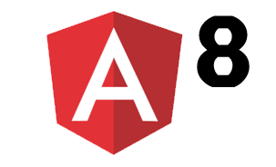


Introduction to
Angular 8
By Chehir Dhawedi
Tech Enthusiast | Senior Full Stack Developer | CTO @ FivePoints

Slide 2
Agenda
What's a Web App
What’s Angular
Why Angular
Components
One-way binding
Angular Service
Demo

Slide 3

Our Programs :
Level 1: for Starter (Algorithms, HTML, CSS)
Level 2: for Beginner ( JS + Firebase )
Level 3: for Amateur (Bootstrap, Angular)
Level 4: for Proficient (NodeJS, ExpressJs, MongoDB, Angular advanced)
Level 5: for Expert (Deployment, Cloud, DevOps, CD/CI)

Slide 4

FivePoints Mindset: “If you’re not having Fun, you’re not learning. There is pleasure in finding things out.” (Feynman)

Slide 5
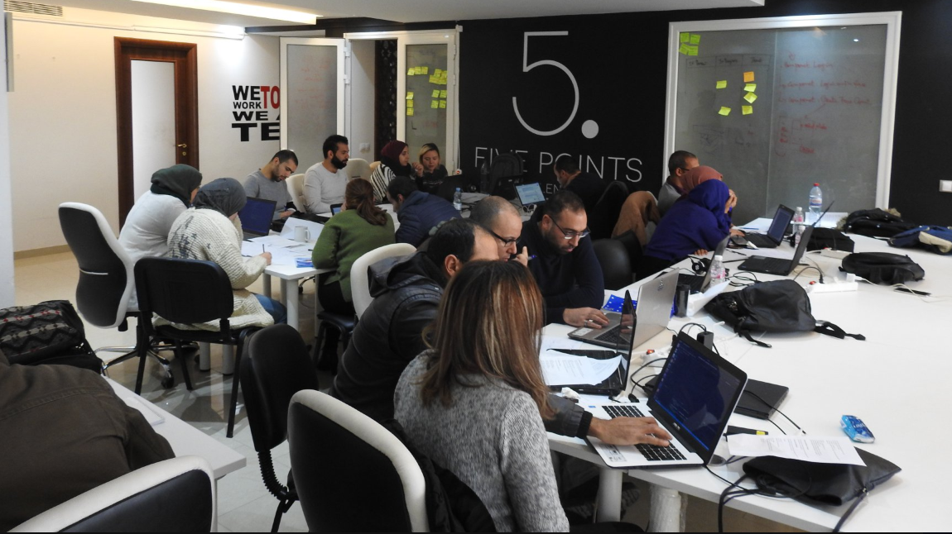
How we do it ?
Simuler l’environnement de l’entreprise
Soft Skills & Coding
Projets réels
Expérience Professionnelle
Prototype Startup

Slide 6



Requirements

Slide 7


Slide 8
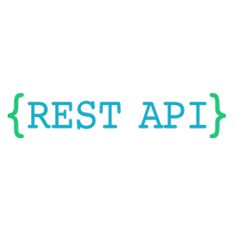
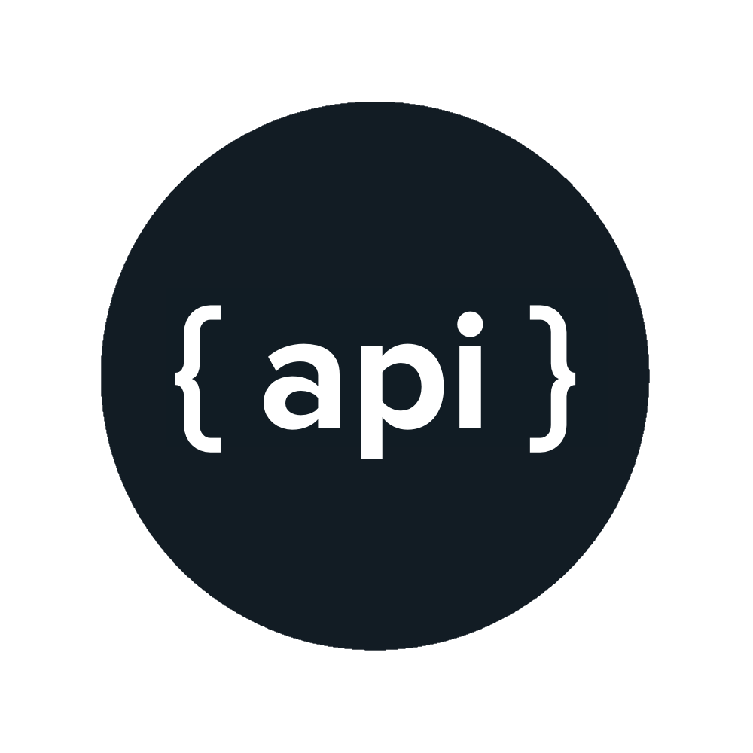

What is an API ?

Slide 9
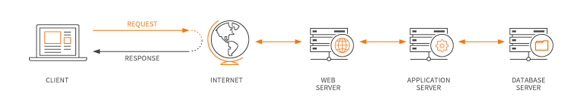
I always ask myself, ‘Does it do something?

Slide 10
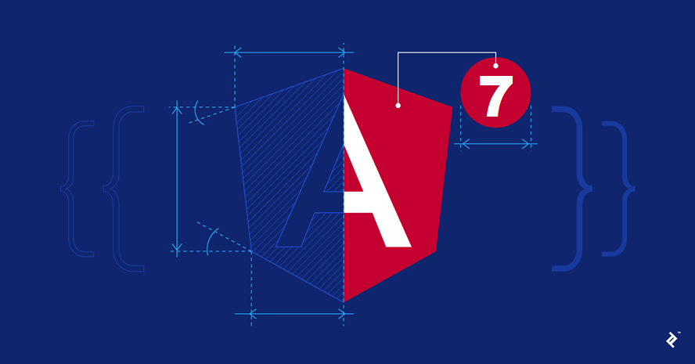
“When the tooling handles the process, developers can focus on the users’ needs”

Slide 11
History of Angular
AngularJS
Angular 2
2010
2016

Slide 12
History of Angular
2.0
2.1
2.2
2.3
4

Slide 13
History of Angular
@angular/core | 2.3.0
@angular/compiler | 2.3.0
@angular/http | 2.3.0
@angular/router | 3.3.0

Slide 14
What's new ? - Angular Performance: CLI Budgets by Default - Support for TypeScript 3.1

Slide 15
Command Line Interface for building Angular applications

Slide 16
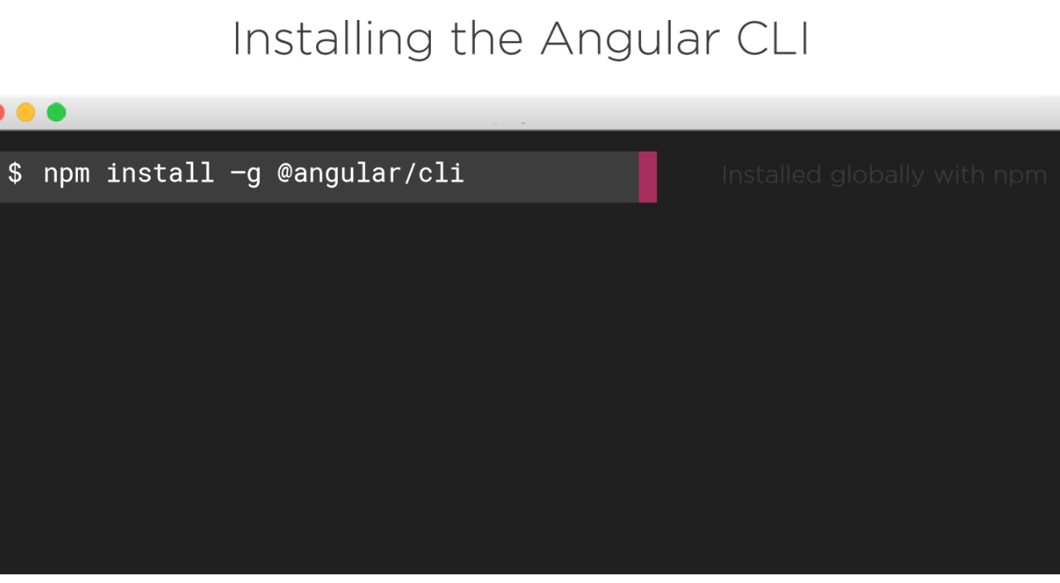

Slide 17
STRUCTURE & ARCHITECTURE
File and Folder Structure LIFT:
Locate code quickly
Identify code at a glance
Flattest structure possible
Try to be DRY (Don’t Repeat Yourself)

Slide 18
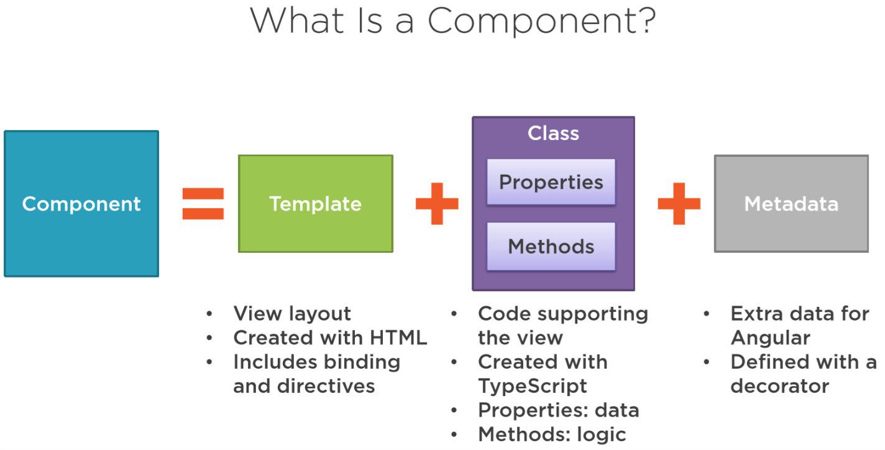

Slide 19
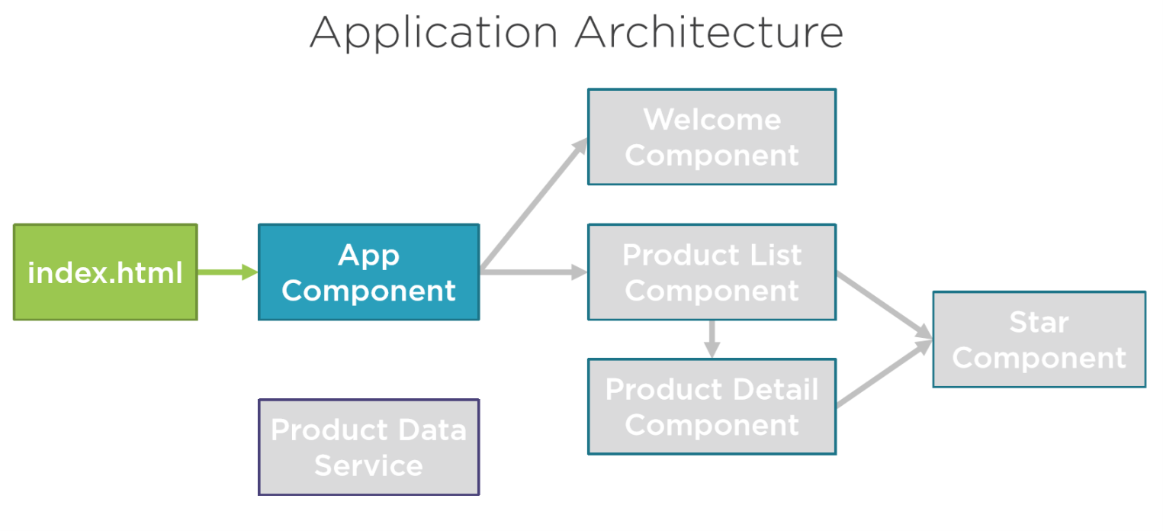

Slide 20
